Slide 1
Designing an Autonomous Workbench for Data Science on AWS
Dipen Chawla
Data Engineer, Episource LLC

Slide 2
Need for a dedicated ML Workbench

Slide 3
Shortcomings of shared dev environments
Jupyter notebook servers on EC2
Limited scalability
Requires DevOps intervention
Cannot access secure data with role-based access
No auto-shutdowns
Difficult to personalise

Slide 4
What we needed in an ML workbench

Slide 5
Key Features
Must not reinvent the wheel
Scale sensibly
Personalised user pods
Users could be given access to shared datasets
Encryption and closed-door security

Slide 6
Arriving at the right picture
Notes:
The core section of the presentation - how did we actually implement this?

Slide 7
Using Jupyterhub on Kubernetes
Data Scientists accustomed to Jupyter ecosystem + lots of ML extensions!
Provided extensive number of integrations via spawners
Decided to go ahead with AWS EKS
Kubespawner in zero-to-jupyterhub fit our use-case
Added customisations like Auto-Shutdown, IAM roles for service accounts and volume mounting via AWS EFS

Slide 8
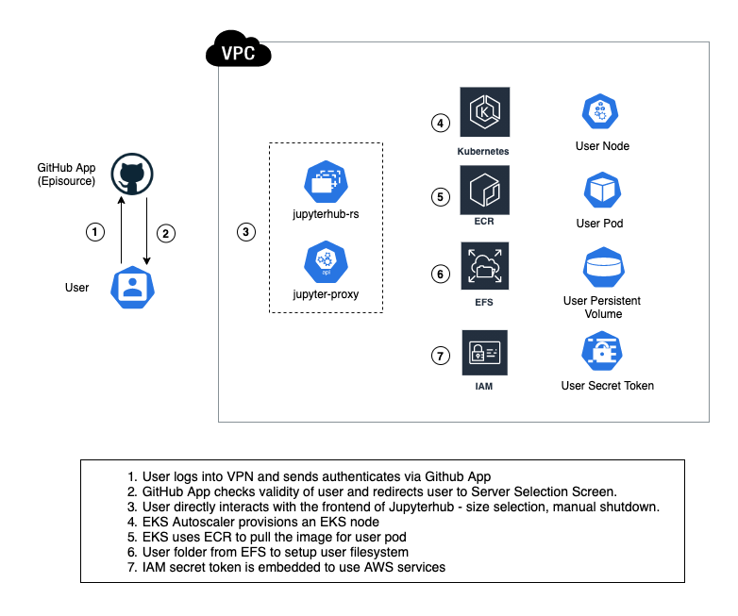

Slide 9
User Storage
EFS storage mounted to each user pod at startup for user filesystem
User files persisted even after each session terminated
Additional datasets (present as Persistent Volumes) can be mounted to user pods, if required
EFS and Persistent Volumes are encrypted at all times

Slide 10
User Management
Workbench authentication via GitHub
Ensures only organization members of Episource can access
Further, an app-level firewall to restrict the access to members of ML team
Jupyterhub admins can view activity and have access to individual folders

Slide 11
User Access Control
Configure user pods to use Kubernetes Service Accounts
Each SA is configured to use a dedicated IAM role
Ensures that each user can access only the data they are authorised to

Slide 12
Impact of the workbench on ML development cycle

Slide 13
How the workbench has helped ML teams
Work with familiar ecosystem across all stages of development
Can perform high compute analysis jobs
Hypotheses take lesser time to turn into features
Auto shutdown and RBAC = less monitoring overhead
Can share files / data by moving them to shared folders

Slide 14
Key Takeaways

Slide 15

What we’ve learned so far
Standing on the shoulders of giants - for open source
Autonomy is the key when building tools to help your ML team to succeed
Your design may not work at first - keep iterating !
Never look past security aspects of your architecture

Slide 16

Thank you!
- @dipen_chawla

